Slide 1

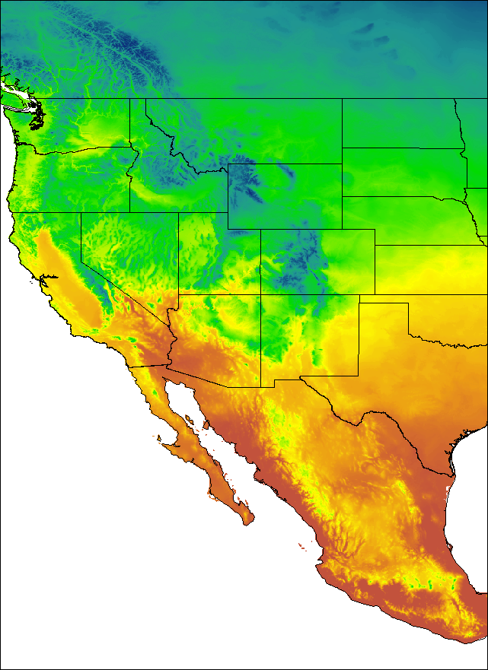
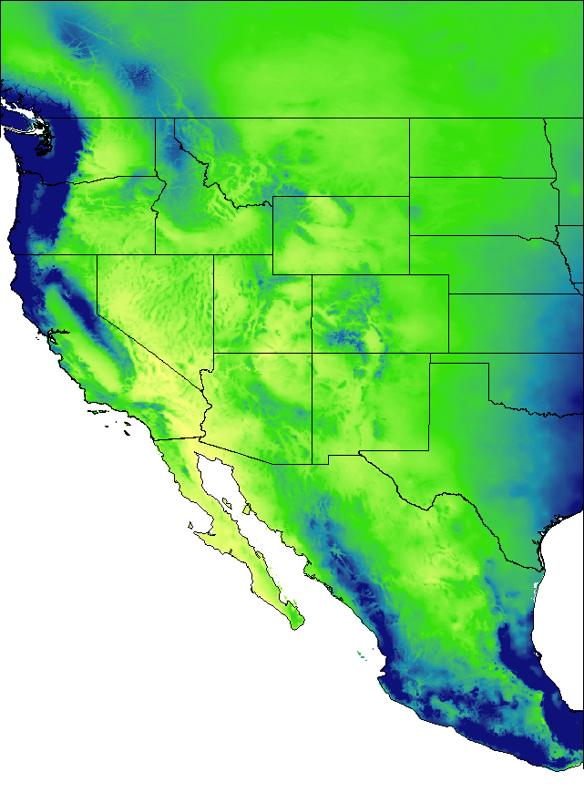
Computer Science in Modern Biology:
Student Advancement Workshop
Ecological niche modeling (in R)
Tereza Jezkova
Jason Bracken
Steve Hein

Slide 2
What’s an ecological niche?
is the spectrum of environmental factors that can be potentially utilized by a species
temperature
precipitation

Slide 3

What’s an ecological niche?
temperature
precipitation

Slide 4
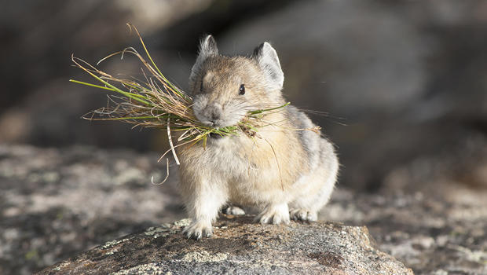
What’s an ecological niche?
TREES
vegetation
GRASS
SAND
substrate
ROCKS

Slide 5
What’s your organism’s niche?

Slide 6
What’s fundamental and what’s realized niche?
FUNDAMENTAL NICHE

Slide 7
What’s fundamental and what’s realized niche?
Biotic factors
Historical
factors
REALIZED
NICHE
Realized
environment

Slide 8
What can we do with ecological niches?

Slide 9
Ecological niche modeling
species
It’s niche
It’s distribution

Slide 10
What can ecological niche models be used for?

Slide 11
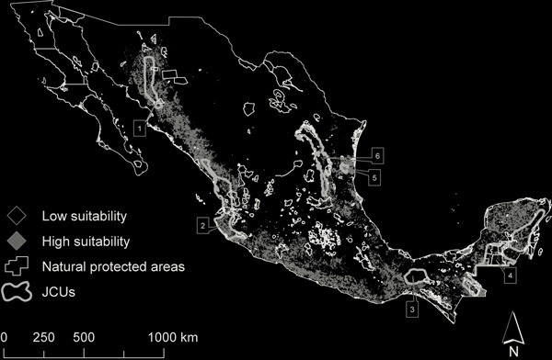
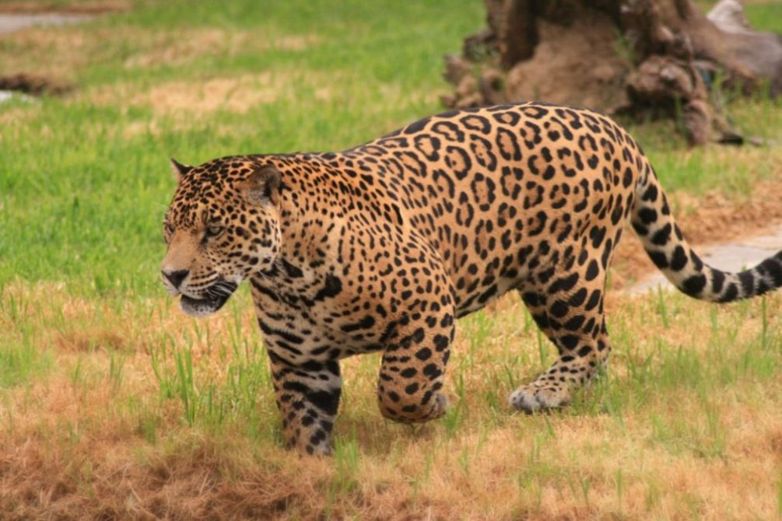
What can we do with modeled species distributions?
Conservation priority areas

Slide 12
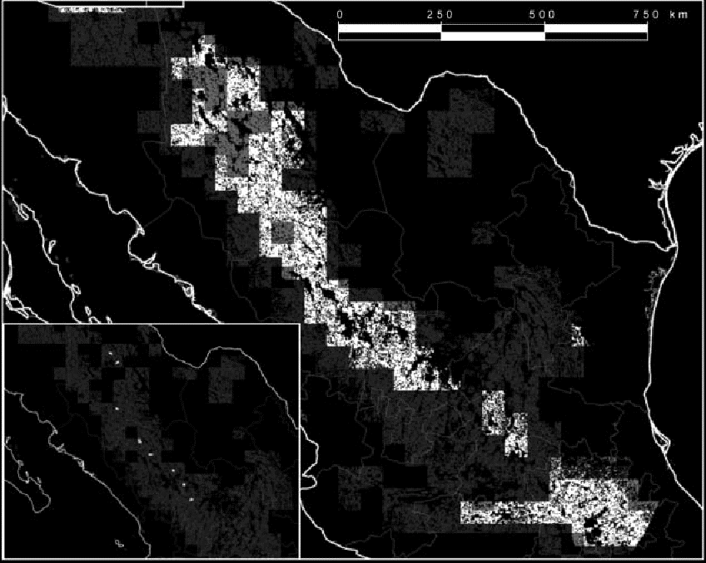
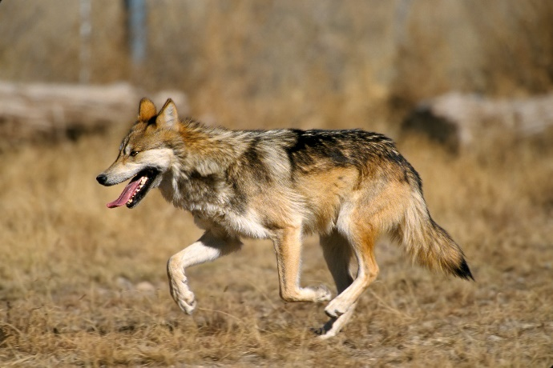
What can we do with modeled species distributions?
Reintroductions

Slide 13
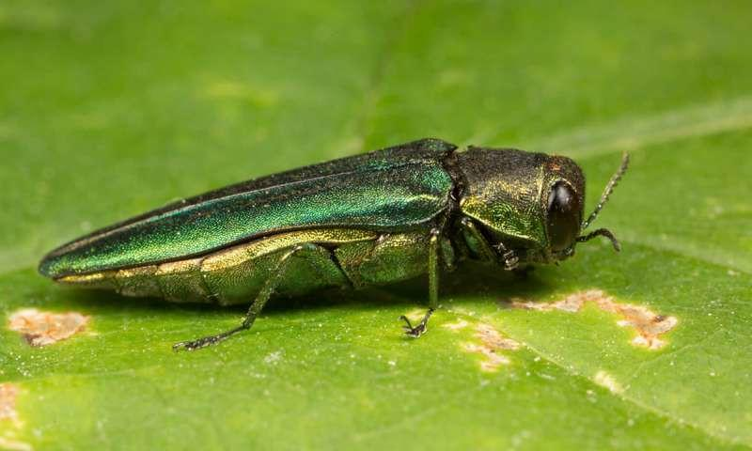
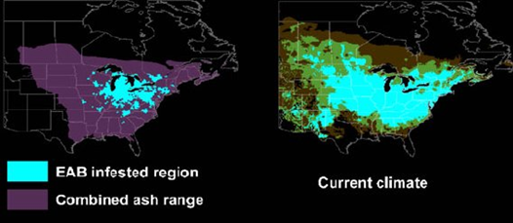
What can we do with modeled species distributions?
Invasive species suitable areas

Slide 14

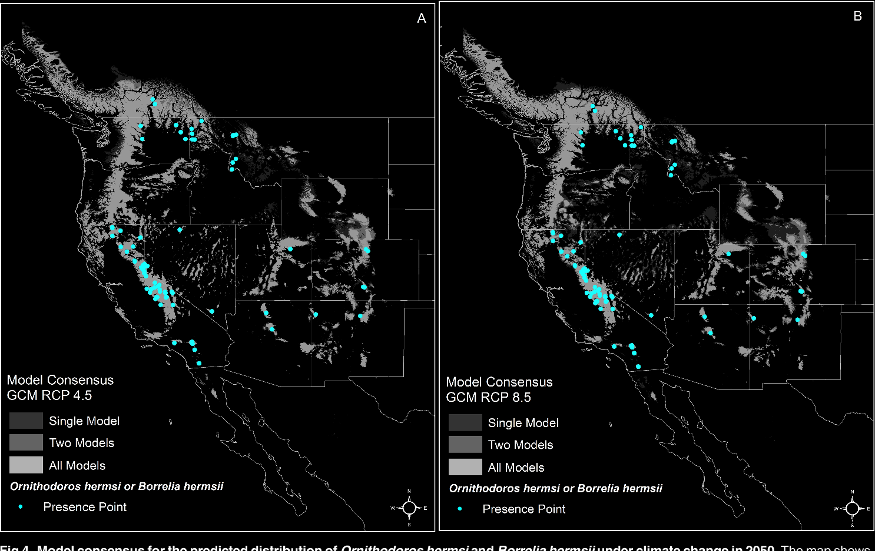
What can we do with modeled species distributions?
disease spread under climate change

Slide 15
How to do ecological niche modeling:
Occurrence
records
Notes:
To do that I used the methodology of ecological niche modeling. I will give you a simple overview of this method so you know how it works.
First you assemble occurrence records, that is, localities where you know the species occurs (these can represent your sampling localities or museum records). Next you will need maps of environmental variables, ideally those that are likely limit distribution of your species. For example different aspects of temperature and precipitation. But others, such as soils, landcover can be useful.

Slide 16

How to do ecological niche modeling:
+
Occurrence
records
Environmental
maps
Notes:
To do that I used the methodology of ecological niche modeling. I will give you a simple overview of this method so you know how it works.
First you assemble occurrence records, that is, localities where you know the species occurs (these can represent your sampling localities or museum records). Next you will need maps of environmental variables, ideally those that are likely limit distribution of your species. For example different aspects of temperature and precipitation. But others, such as soils, landcover can be useful.

Slide 17
How to do ecological niche modeling:
+
Occurrence
records
Environmental
maps
Notes:
Next, you overlay records over climatic maps and identify climatic conditions that are suitable for the species = suitable niche. This is not done manually, there are a lot of algorithms available that will identify the suitable niche. I recommend the R package dismo that gives you a lot of options and flexibility.

Slide 18
How to do ecological niche modeling:
+
Occurrence
records
Current
Distribution
Model
Environmental
maps
Notes:
The area with the suitable climatic niche, that is, area predicted to be currently occupied by the species, that is, you current distribution model

Slide 19
Are we modeling fundamental or realized niche?
Biotic factors
Historical
factors
REALIZED
NICHE
Realized
environment

Slide 20
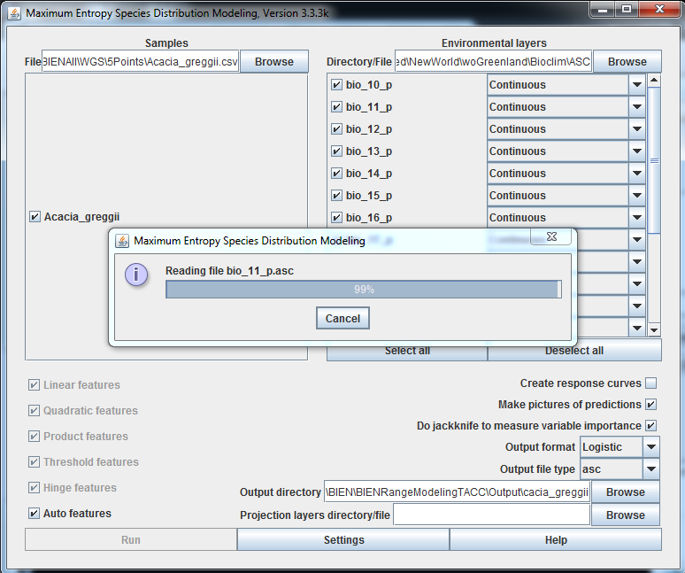
How to do ecological niche modeling: MAXENT
https://biodiversityinformatics.amnh.org/open_source/maxent/

Slide 21

How to do ecological niche modeling:
MAXENT, yes, but …………….. in

Slide 22
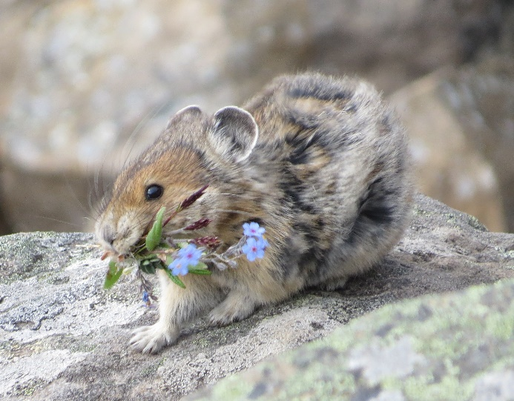
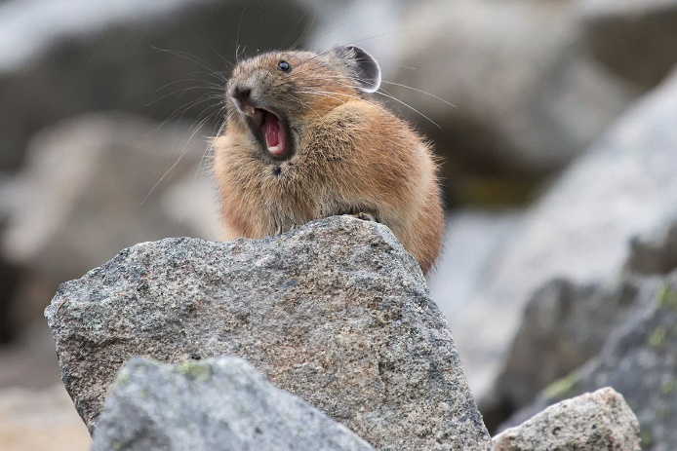
Objective: how do pika’s distribution change in respond to climate change?
Approach: build ENMs for the past, current, and future climates
Predictions: ???
Formulate predictions
2) Build ENMs for the LGM climate, current climate, and future climate
3) Prepare 1 slide or page that includes Predictions and Results

Slide 23


How do species respond to climate change?
10
10
Suitable
niche
20
20

Slide 24

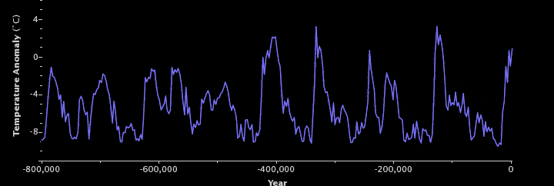
Global Annual Temperature Change (last 800,000 years)
0 YBP
21,000 YBP
Notes:
One approach is to look into the past. Species have always experienced fluctuating climate. Here you can see the trend in temperature over the last 800 years. One of the most extreme and rapid changes happened relatively recently. It is the period between the LGM, 21K ago, and present time

Slide 25
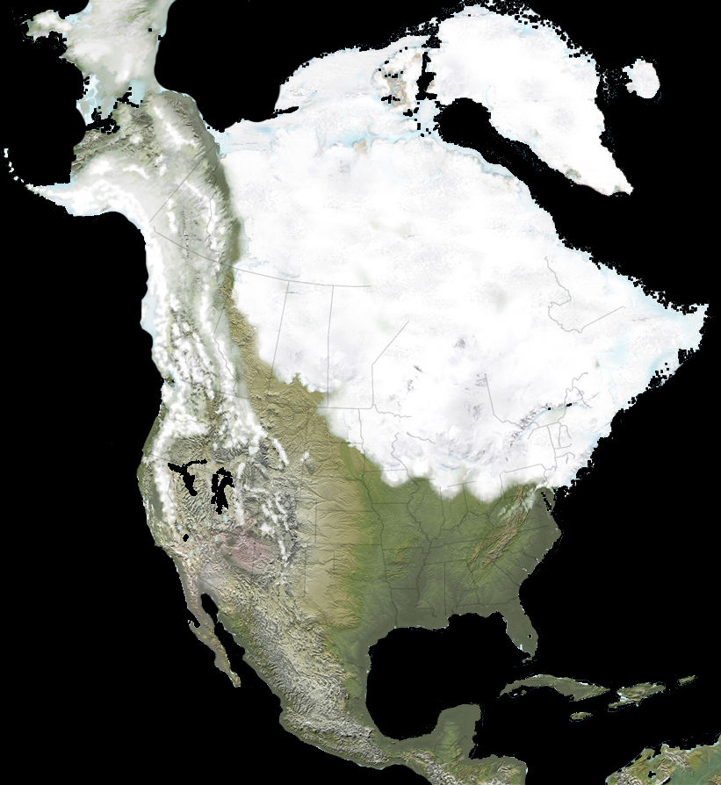
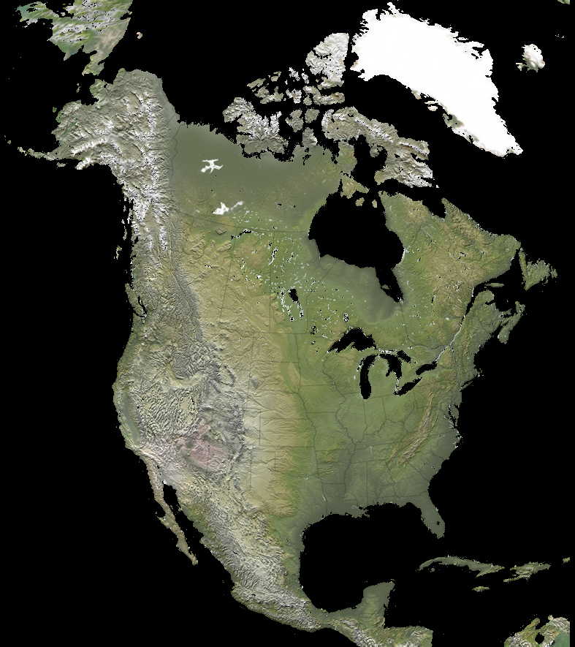
Climate change after the Last Glacial Maximum (LGM)
Last Glacial Maximum
Present time
0 YBP
21, 000 YBP
warming
Notes:
During the LGM, temperatures were lower, precipitation higher and large portions of NA covered with ice sheet. After the LGM and into the present time, the climate warmed up and the ice sheets disappeared.

Slide 26

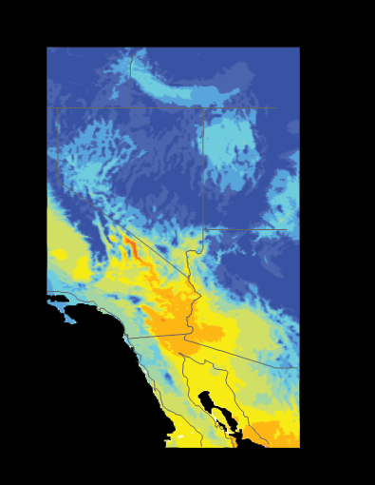
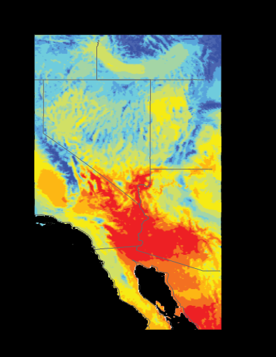
Climate change after the Last Glacial Maximum (LGM)
Last Glacial Maximum
Present time
warming
Notes:
this map shows the mean summer temperature during the LGM and present time in the southwest. The temperature goes from blue (colder) to red (warmer) and it shows that the southwest is ca. 8 degrees C warmer now than it was during the LGM.

Slide 27
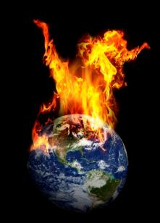
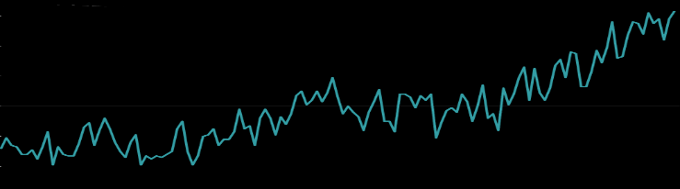
6
Global Annual Temperature Change
Projection to 2100
Emissions NOT reduced
4
Global Annual Temperature Change (°C)
Emissions reduced
2
0
1900
1950
2000
2050
2100
National Climate Assessment, 2016
Notes:
Even more alarming/concerning/troubling is the projected increase in global temperature over the next 80 years.

